Slide 1

Soft skills training

Slide 2
Communication skills
Verbal Communication
Non-verbal Communication
Body language,
Eye contact,
Facial expressions,
Appearance,
Tone of voice
Language,
Clarity,
Tone of voice(how something said),
Grammer and vocabulary

Slide 3


Self introduction
Key points :
Be brief ( 1minute – 1 min 30 secs)
Greetings…
Be clear about your name and role
Be professional to highlight your key skills and relevant experiences.
End with a purpose

Slide 4
Sample introduction
Good morning/afternoon, my name is Akalya, and I’m currently pursuing a Bachelor’s degree in Information Technology from [your college/university name]. Throughout my studies, I’ve developed a strong foundation in IT concepts, particularly in areas like software development, database management, and data structures.
I’ve had the opportunity to work on several projects that have allowed me to apply these skills in real-world scenarios. For instance, I worked on a [mention a relevant project, e.g., web development project using HTML, CSS, and JavaScript, or building a database management system], which enhanced my problem-solving skills and my ability to collaborate with team members effectively.
In addition to my academic work, I’ve also completed internships/certifications in [mention any relevant internships or certifications if applicable, e.g., cloud computing, programming languages like Python or Java], which helped me deepen my understanding of practical applications in the IT industry.
I am particularly excited about this opportunity because I am passionate about [mention the job role or area of interest, e.g., software development, IT solutions] and I am eager to contribute and learn in a dynamic team. I am confident that my skills, coupled with my enthusiasm for technology, will allow me to bring value to your company. Thank you for the opportunity.

Slide 5







Group discussion – gd round
Take Initiation
Preparation
Effective Communication
Avoid interruption
MODERATOR
Active listening
Respectful Discourse
Discussion Leader

Slide 6



RESUME WRITING
Customize Your Resume: Tailor your resume for each job application by aligning your skills, experiences, and keywords with the job description. Highlight the most relevant qualifications that match the specific requirements of the role.
Tailored Content
A one-page resume forces you to prioritize the most relevant information, ensuring that only your strongest qualifications and experiences are highlighted. This makes it easier for hiring managers to quickly assess your fit for the role.
One-page Resume
Use a clean, professional format with clear headings and bullet points for easy readability. Keep it concise, ideally to one page for entry-level positions, and ensure consistent font and spacing throughout.
Clear structure and Format

Slide 7

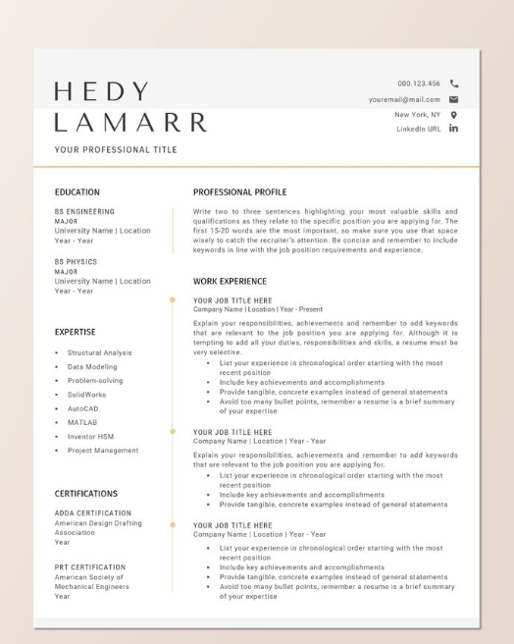
SAMPLE RESUME

Slide 8

Effective tips for preparing for a interview
Research the Company
Practice Common Interview Questions
Prepare Your Own Questions
Practice Your Responses
Dress Appropriately
Prepare Necessary Documents
Plan Your Journey
Stay Calm and Confident
Follow Up
Reflect and Learn

